Slide 1


Department of Computer Science and Engineering
CS19811 – Project Phase-II
WATER QUALITY ANALYSIS
Dr.S. Vinodkumar
Professor
Balaji P 210701038
Dakshnamoorthy M 210701045

Slide 2
Abstract
This study applies machine learning techniques to evaluate and predict water quality using bi-weekly data collected by volunteers at the Refuge. The dataset includes measurements of turbidity, pH, dissolved oxygen, salinity, and temperature from various water bodies, including the Bay and several pools. The goal is to develop accurate predictive models for water quality assessment. Various algorithms, such as decision trees, random forests, and neural networks, are compared. Initial results show that random forests provide the highest accuracy and reliability. This approach offers an efficient solution for real-time water quality monitoring, with significant implications for environmental management and public health. Future work aims to integrate real-time data and expand the model's applicability to different regions.

Slide 3
Existing System
The current system for monitoring water quality at the Refuge relies on manual data collection by volunteers, who measure parameters such as turbidity, pH, dissolved oxygen, salinity, and temperature bi-weekly. These measurements are taken at designated locations across various water bodies, including the Bay and multiple pools. Data is recorded and stored in spreadsheets or databases, which are then used for periodic analysis to identify trends and anomalies. However, this manual process is time-consuming, prone to human error, and lacks real-time monitoring capabilities. Additionally, the analysis is often limited to basic statistical methods, which may not fully capture complex patterns in the data. This highlights the need for an automated, real-time predictive system to enhance water quality management.

Slide 4
Proposed System
The proposed system utilizes machine learning techniques to automate and enhance the assessment and prediction of water quality at the Refuge. By integrating bi-weekly measurements of turbidity, pH, dissolved oxygen, salinity, and temperature, collected by volunteers, the system employs algorithms such as decision trees, random forests, and neural networks to develop predictive models. These models aim to provide real-time water quality analysis, identifying trends, anomalies, and potential contaminants with greater accuracy and efficiency. The system includes automated data preprocessing, feature engineering, and model optimization to improve reliability. Additionally, the integration of real-time data streams will enable continuous monitoring and timely interventions, significantly improving environmental management and public health outcomes.

Slide 5
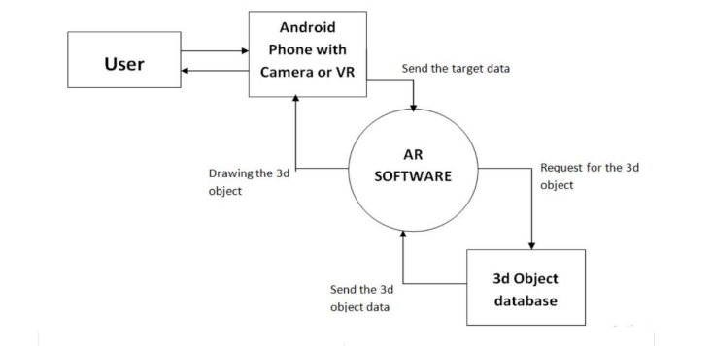


System Architecture
Android with camera or VR

Slide 6
List of Modules
Data Collection and Preprocessing Module
Exploratory Data Analysis (EDA) Module
Model Training and Evaluation Module
Prediction and Evaluation Module
Visualization and Reporting Module

Slide 7
Functional Description for each modules
Data Collection and Preprocessing Module: The Data Collection and Preprocessing Module automates the gathering of water quality measurements, including turbidity, pH, dissolved oxygen, salinity, and temperature, from various water bodies such as the Bay, D-Pool, C-Pool, B-Pool, and A-Pool. This module integrates data collected bi-weekly by volunteers and ensures that the data is systematically organized and stored. It performs essential preprocessing tasks such as data cleaning to remove inconsistencies and errors, normalization to standardize the data range, and transformation to convert raw measurements into formats suitable for analysis. This module also handles missing data imputation and feature scaling to prepare the dataset for machine learning. By ensuring high-quality and consistent data, this module lays the foundation for accurate and reliable predictive modeling and analysis.

Slide 8
Functional Description of Module
Exploratory Data Analysis (EDA) Module: The Exploratory Data Analysis (EDA) Module is designed to provide comprehensive tools for visualizing and analyzing the water quality dataset. This module enables the identification of trends, correlations, and anomalies within the data. It employs various statistical techniques and visualization methods, such as histograms, scatter plots, box plots, and correlation matrices, to explore the relationships between different water quality parameters. By offering interactive and detailed visual insights, the EDA Module helps stakeholders understand the underlying patterns and distributions in the data. This understanding guides the feature engineering process and informs the development of predictive models. Additionally, the EDA Module aids in detecting data quality issues and outliers, ensuring that subsequent analyses and model training are based on accurate and reliable data.

Slide 9
Functional Description of Module
Model Training and Evaluation Module: The Model Training and Evaluation Module is designed to develop and refine predictive models for water quality assessment. It implements various machine learning algorithms, including decision trees, random forests, and neural networks, to train models using the preprocessed dataset. This module involves hyperparameter tuning and cross-validation to optimize model performance. It evaluates the models using metrics such as accuracy, precision, recall, and F1 score to identify the most effective algorithm. The module also includes functionality for comparing different models and selecting the best one based on their performance. This ensures that the chosen model provides accurate and reliable predictions, which are crucial for real-time water quality monitoring and decision-making.

Slide 10
Functional Description of Module
Prediction and Alert Module: The Prediction and Alert Module utilizes trained machine learning models to perform real-time analysis of water quality data, predicting potential issues based on current and historical measurements. It continuously monitors key parameters such as turbidity, pH, dissolved oxygen, salinity, and temperature. When the model detects values that exceed predefined safety thresholds or identify significant anomalies, the module generates automatic alerts. These alerts are communicated to stakeholders via various channels, including email, SMS, or mobile app notifications, ensuring timely awareness and response. The module also includes configurable settings for alert sensitivity and threshold levels, allowing customization based on specific water bodies and environmental conditions. This proactive approach helps in mitigating risks, ensuring the maintenance of safe and healthy water quality standards.

Slide 11
Functional Description of Module
Visualization and Reporting Module: The Visualization and Reporting Module provides intuitive and interactive dashboards for stakeholders to monitor the status and trends of water quality parameters such as turbidity, pH, dissolved oxygen, salinity, and temperature. This module converts raw and processed data into visually appealing charts, graphs, and maps, making complex data easily understandable. It includes features for real-time data updates, enabling continuous monitoring and timely insights. Automated report generation capabilities produce comprehensive summaries of water quality, highlighting key findings, trends, and anomalies. Customizable views allow users to focus on specific parameters or time periods, facilitating targeted analysis. This module enhances decision-making by presenting actionable insights in a clear and concise manner, supporting effective water quality management and environmental protection efforts.

Slide 12
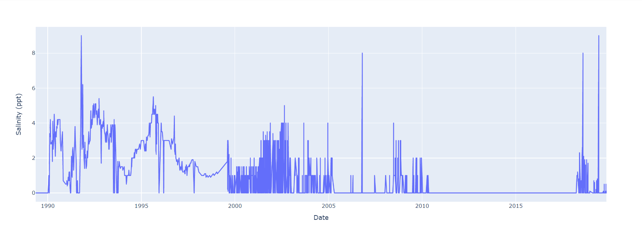
Implementation
Plotting the graph using the given dataset

Slide 13
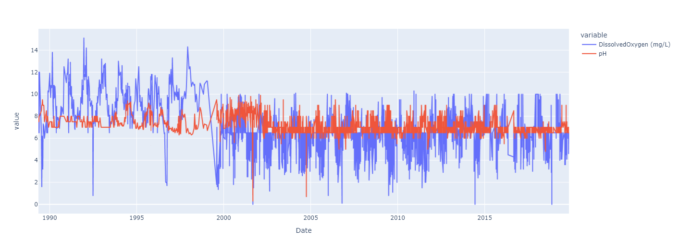
Implementation

Slide 14
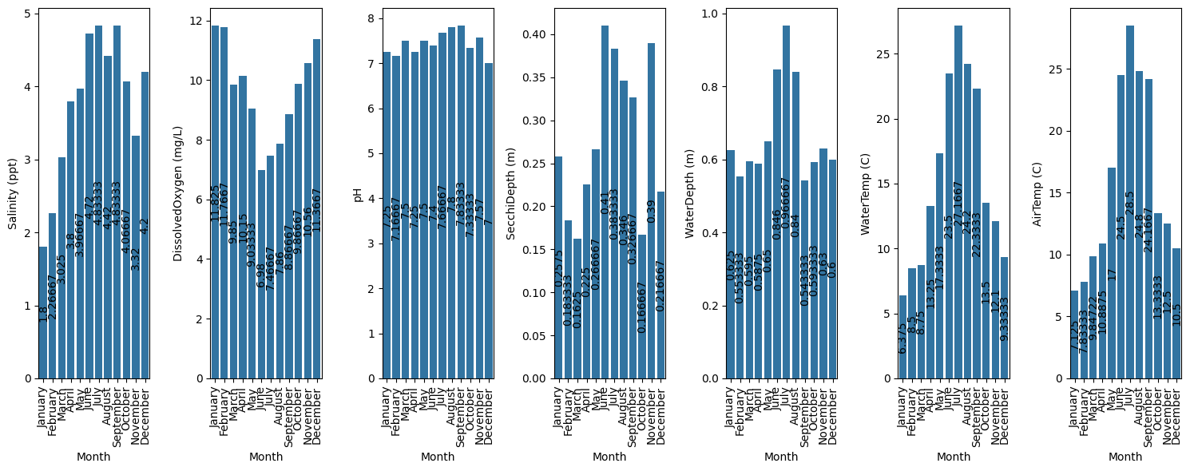
Implementation
Training of data

Slide 15
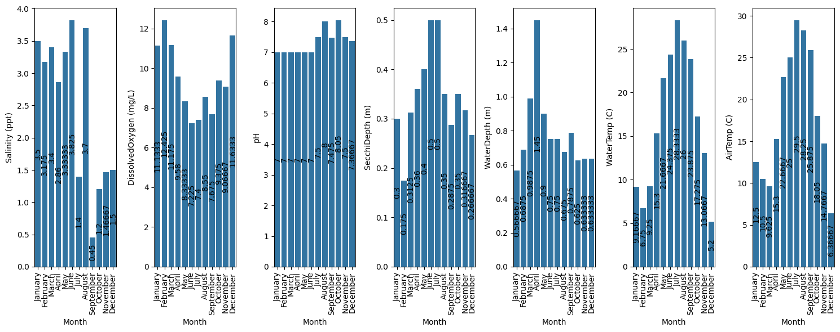
Implementation of Phase II

Slide 16
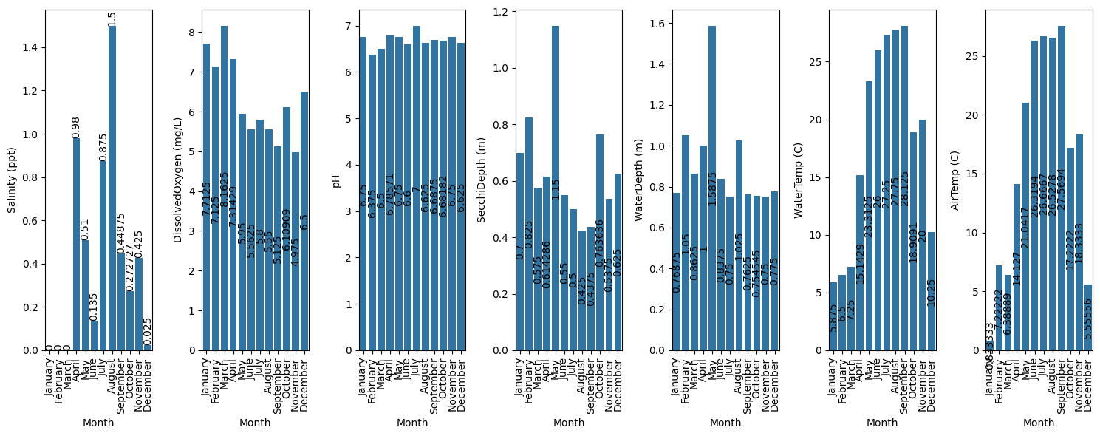
Implementation of Phase II
Testing of data

Slide 17
Conclusion
The implementation of a machine learning-driven water quality monitoring system at the Refuge demonstrates significant advancements in environmental management and public health protection. By automating data collection, preprocessing, and predictive analysis, the system provides real-time, accurate assessments of water quality parameters such as turbidity, pH, dissolved oxygen, salinity, and temperature. The integration of advanced visualization and reporting tools facilitates informed decision-making and timely interventions. The successful application of models like random forests underscores the potential of machine learning in environmental monitoring. Future enhancements, including real-time data integration and broader geographic coverage, will further improve the system's effectiveness and scalability. Overall, this project showcases a modern, efficient approach to safeguarding water resources and promoting ecological sustainability.

Slide 18
References
Breiman, L. (2001). “Random forests.” Machine Learning, 45(1), 5-32. doi:10.1023/A:1010933404324
Friedman, J., Hastie, T., & Tibshirani, R. (2001). The Elements of Statistical Learning: Data Mining, Inference, and Prediction. Springer Series in Statistics.
Huisman, J., Codd, G. A., Paerl, H. W., Ibelings, B. W., Verspagen, J. M. H., & Visser, P. M. (2018). "Cyanobacterial blooms." Nature Reviews Microbiology, 16(8), 471-483. doi:10.1038/s41579-018-0040-1
Zhang, J., Xu, R., Li, Y., & Liang, Y. (2018). "Water quality prediction model based on LSTM." IEEE Access, 6, 72578-72590. doi:10.1109/ACCESS.2018.2882949
Giri, S., & Qiu, Z. (2016). "Understanding the relationship of land uses and water quality in twenty first century: A review." Journal of Environmental Management, 173, 41-48. doi:10.1016/j.jenvman.2016.02.029

Slide 19
Paper Publication Status (Phase-I )
TITLE | : | Immersive Interactive Technology and Enhancing Virtual Shopping using Augmented Reality.
AUTHOR | : | Vindodhkumar S, Kumar P, Raghavendran CS, Rithika S
PUBLICATION | : | Patent
STATUS | : | Filed

Slide 20
Paper Publication Status (Phase-II )
TITLE | : | Evolved Retail:Harnessing Markerless AR to Enhance Virtual Shopping Experience
AUTHOR | : | Vindodhkumar S, Kumar P, Raghavendran CS, Rithika S
CONFERENCE NAME | : | IEEE International Conference on Advances in Information Technology(ICAIT-2024).
PUBLICATION | : | Online
STATUS | : | Accepted

Slide 21
Thank You

